Slide 1
Automatic CRF Annotations Using Hash Tree Algorithm
Pengpeng Li：
possessing a master's degree, is an accomplished expert in the field of bioinformatics, specializing in algorithm design and software development. With over a decade of experience in programming languages such as R, Python, Golang, Perl, and BASH, Pengpeng Li has successfully led multiple open-source software engineering projects, which have been published on GitHub.

Slide 2
Background and Goal
What is the essence of this problem

Slide 3
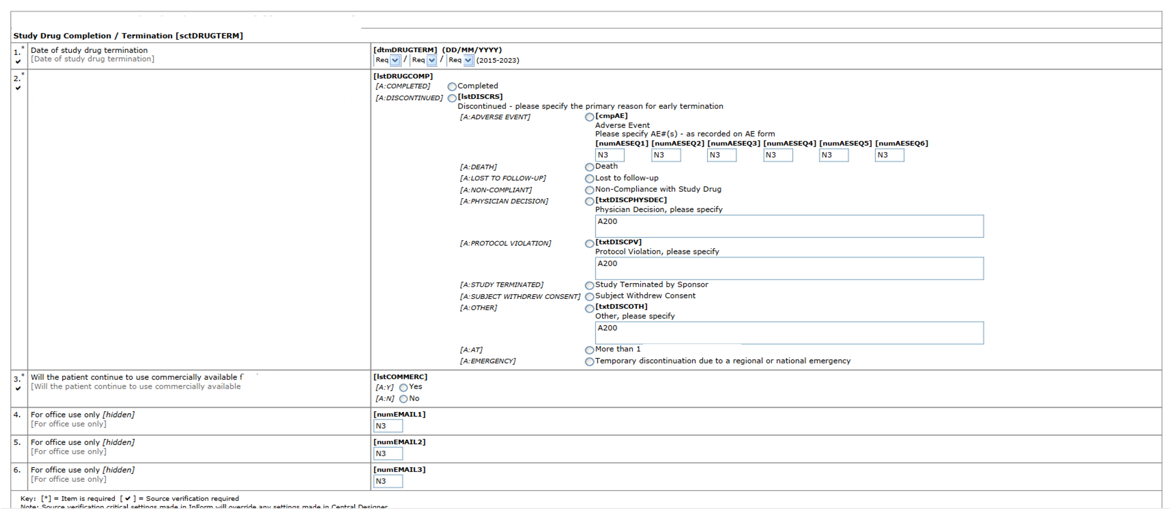
What is the essence of this problem

Slide 4
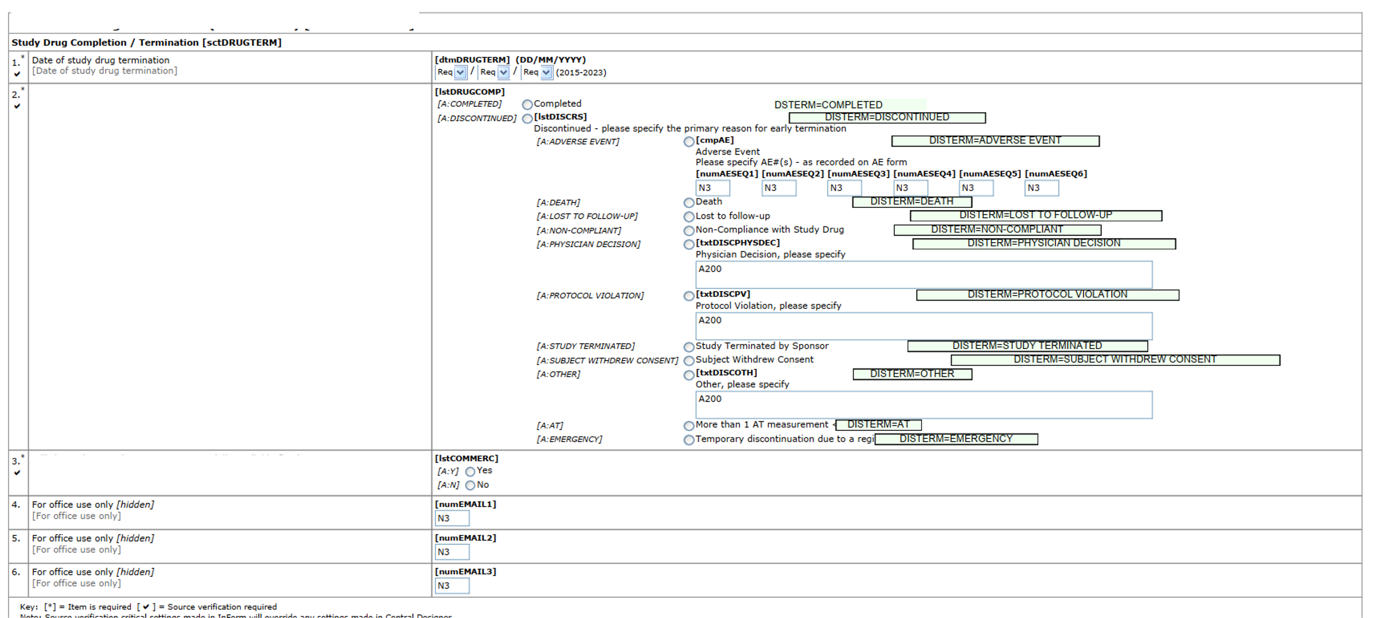
What is the essence of this problem

Slide 5
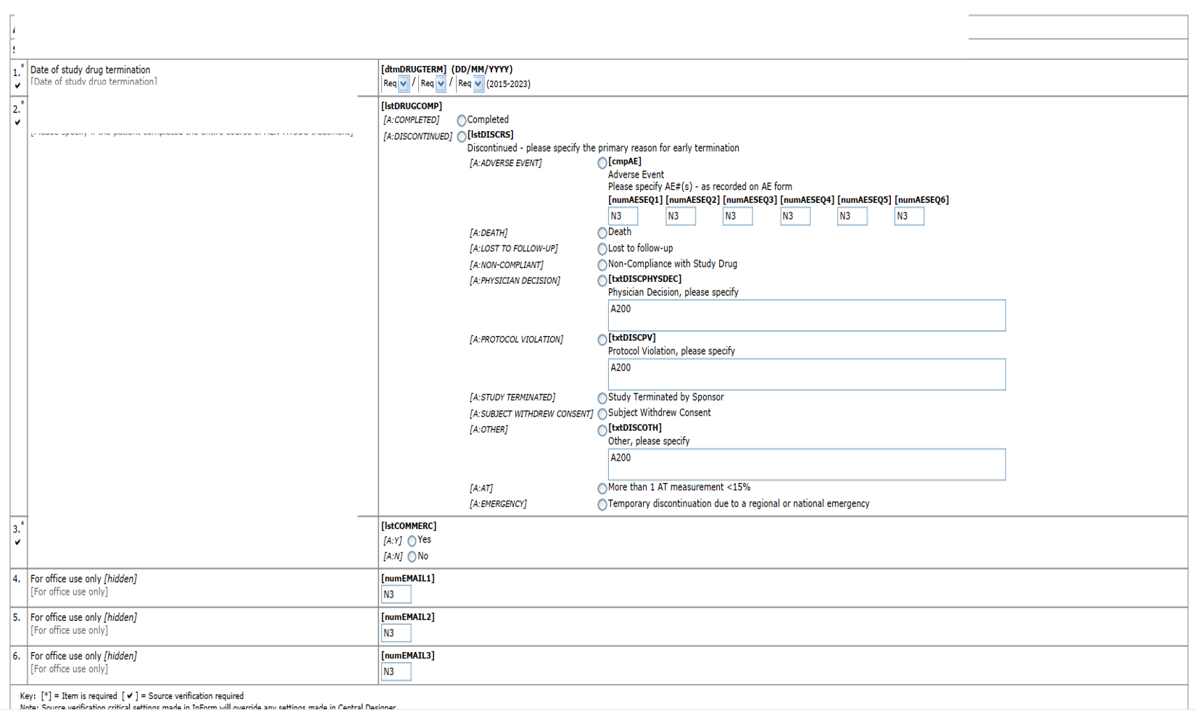
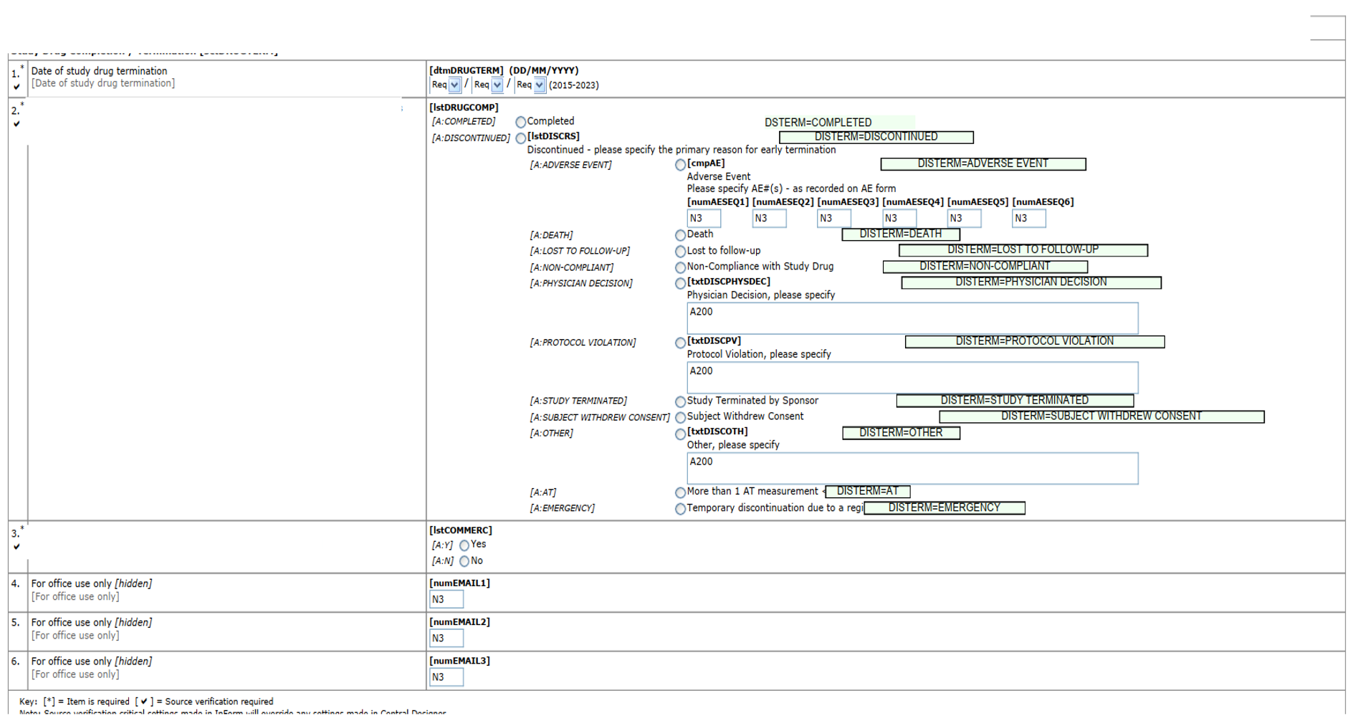
What is the essence of this problem
Essence of the problem
Question
Draw a rectangle on right place
Draw right text in the rectangle
How to tell program where to draw the rectangle
Which Text is right

Slide 6
What is the essence of this problem
How to tell program where to draw the rectangle
Offset value
( PageNumber ,Xstart,Xend,Ystart,Yend )
Relative coordinate system
Hard to implement
Modification Insensitive
Easy to inherit and migrate
Absolute coordinate system
Easy to implement
Modification Sensitive
Challenging to inherit and migrate

Slide 7
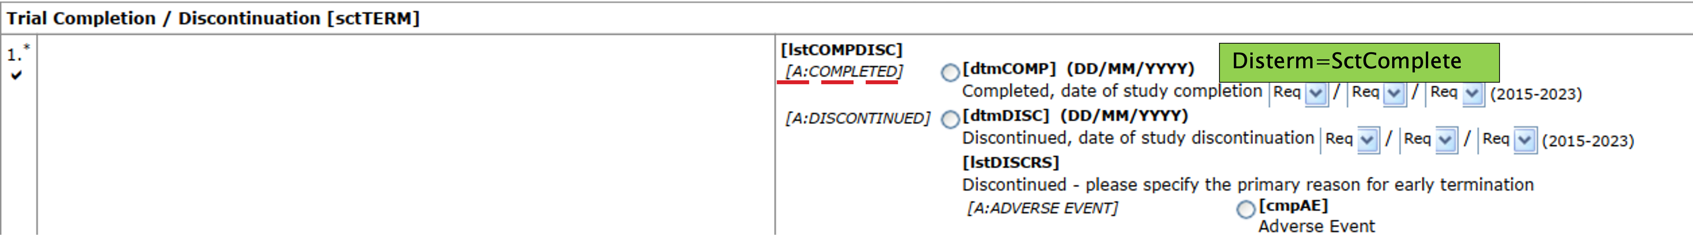
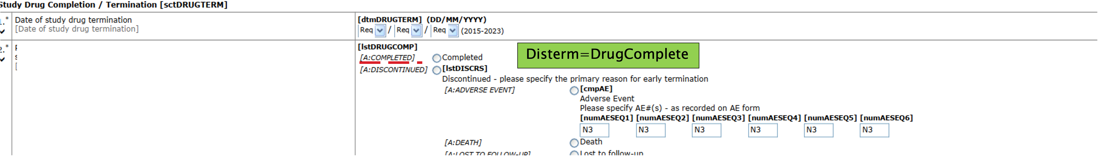
What is the essence of this problem
Which Text is right
Same KeyWord But Different Annotation

Slide 8
What is the essence of this problem
Conclusion
Relative coordinate system is better then absolute coordinate system
Annotation content is relative to the keywords context

Slide 9
Solution and Innovation Point
Using hash tree to build a super cataloge

Slide 10
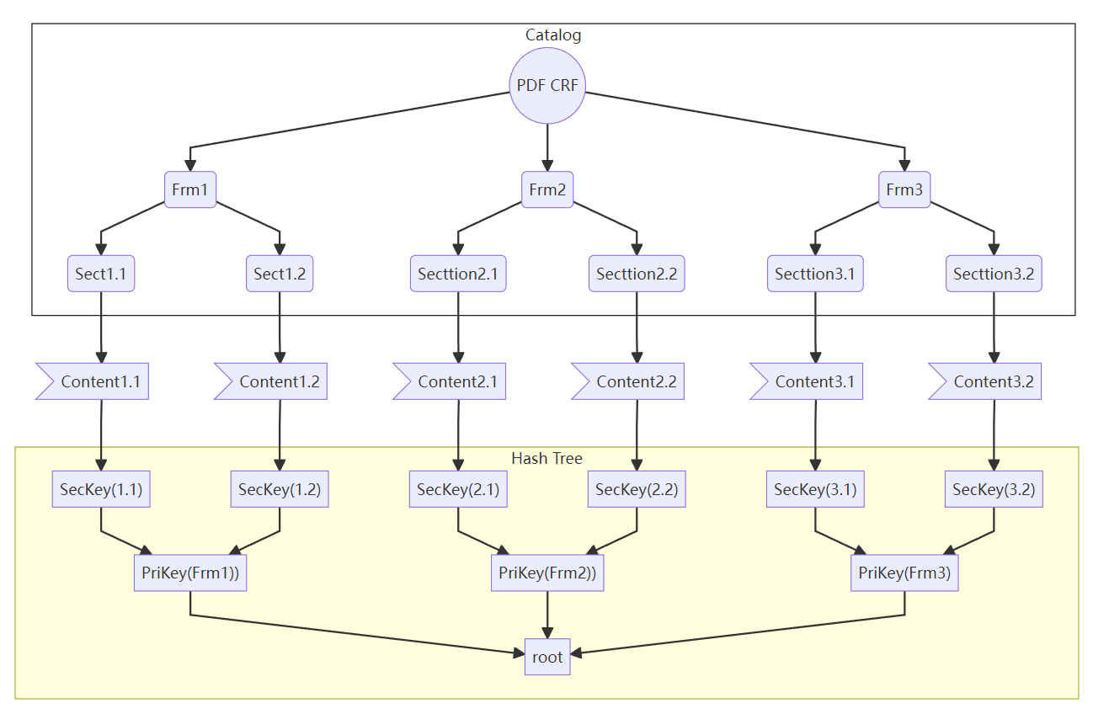
Central idea
Build a Super cataloge store logical hierarchical structure and whole content of document
In this way, all keyword’s context could be store and render in code.
Paper Number AP-117

Slide 11
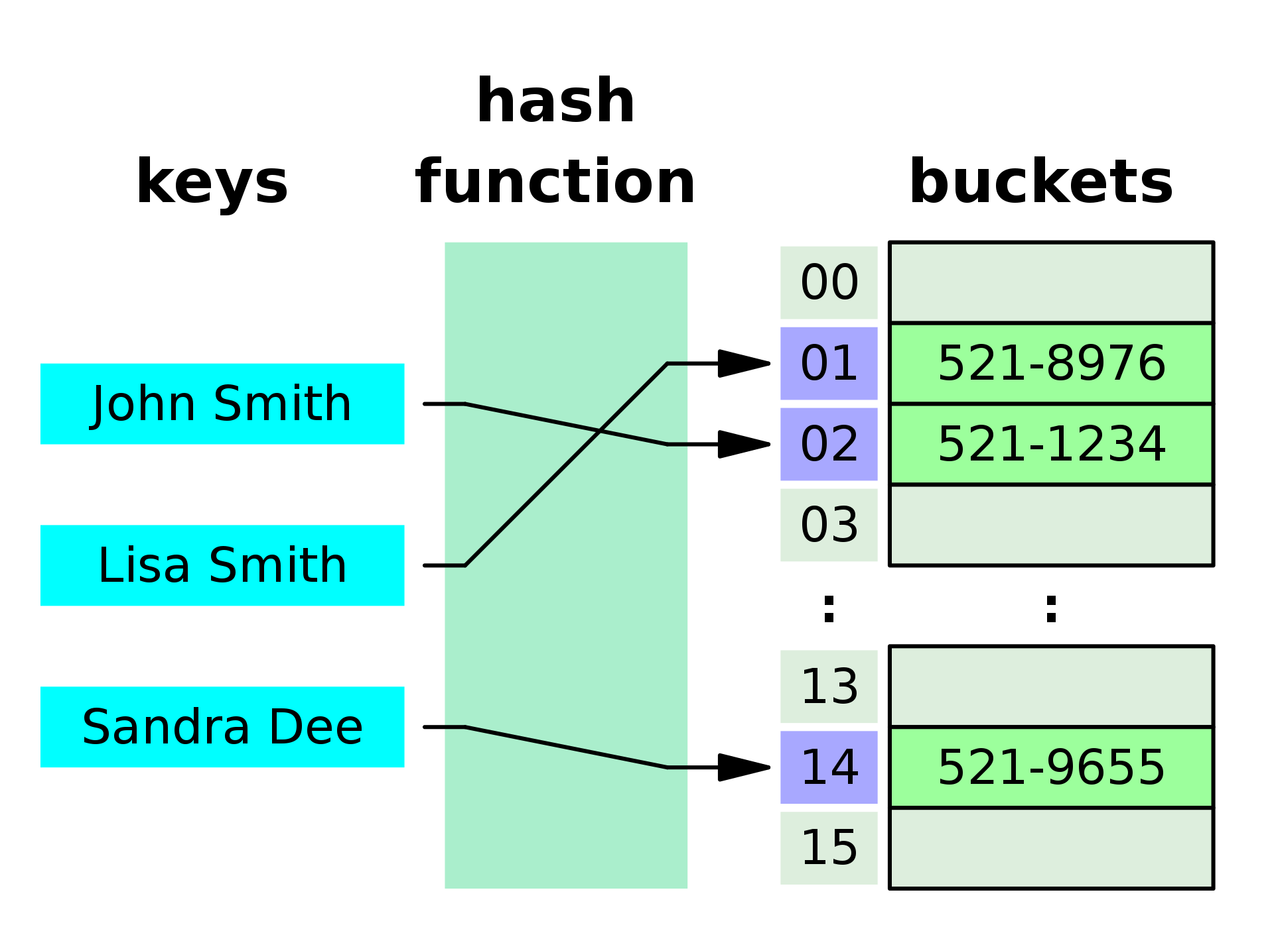
Hashmap & Hash Tree
Paper Number AP-117

Slide 12
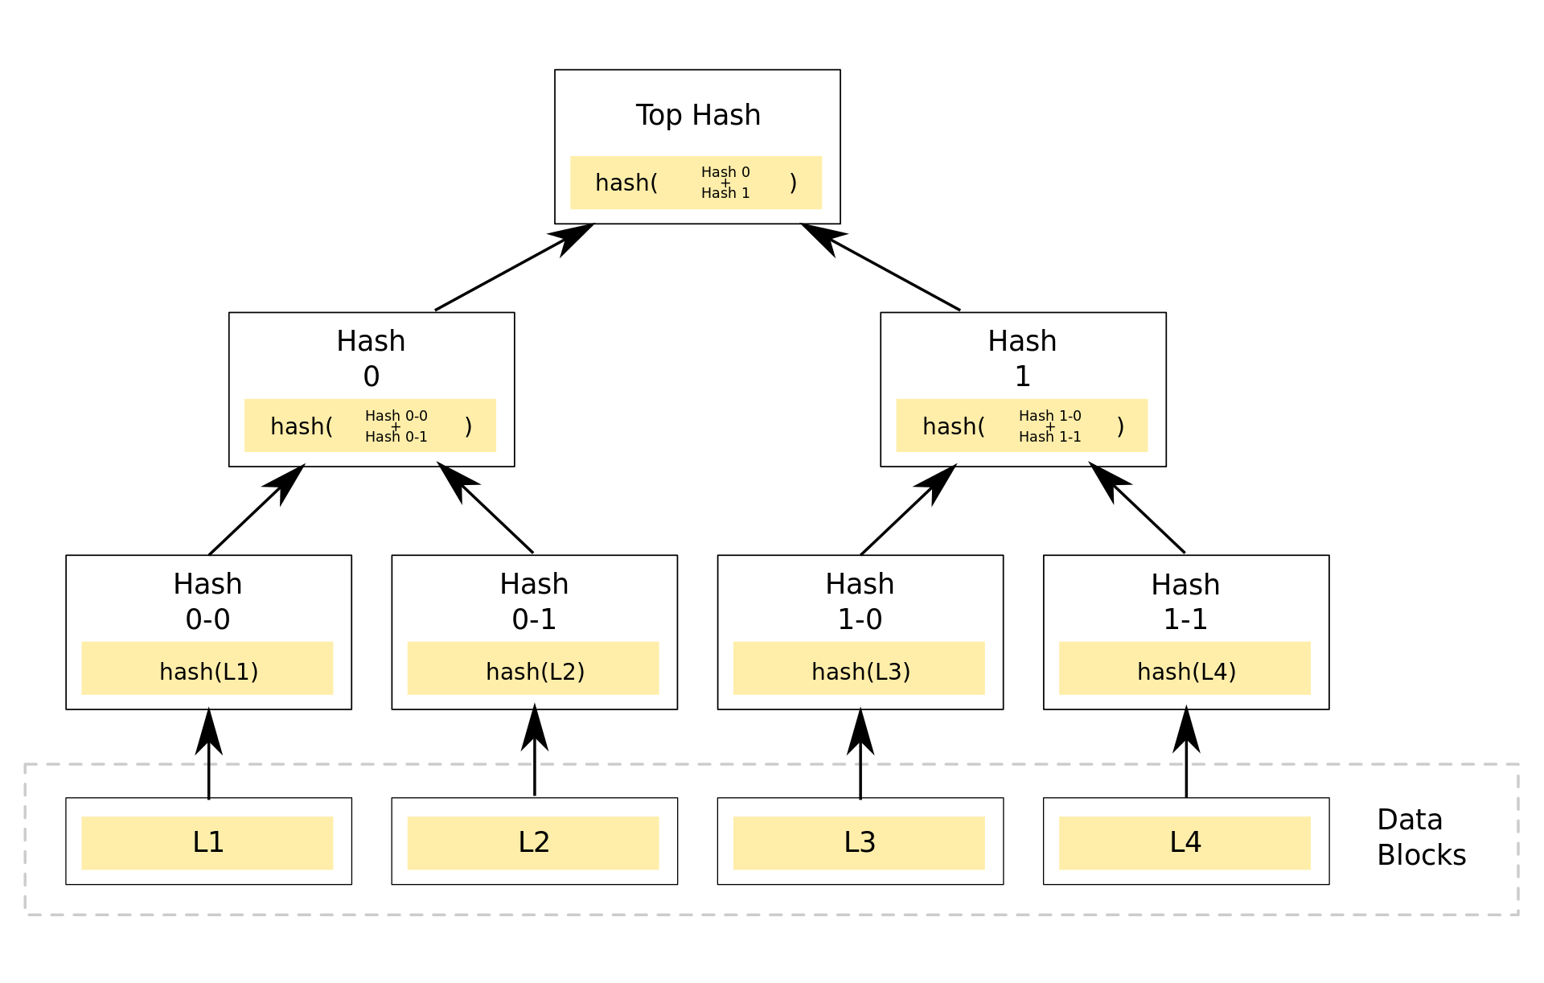
Hashmap & Hash Tree
Highly Condensed
High efficiency for assignment and data retrieval
Easy for visualization
Paper Number AP-117

Slide 13
Implemention
Using hash tree to build a super cataloge

Slide 14
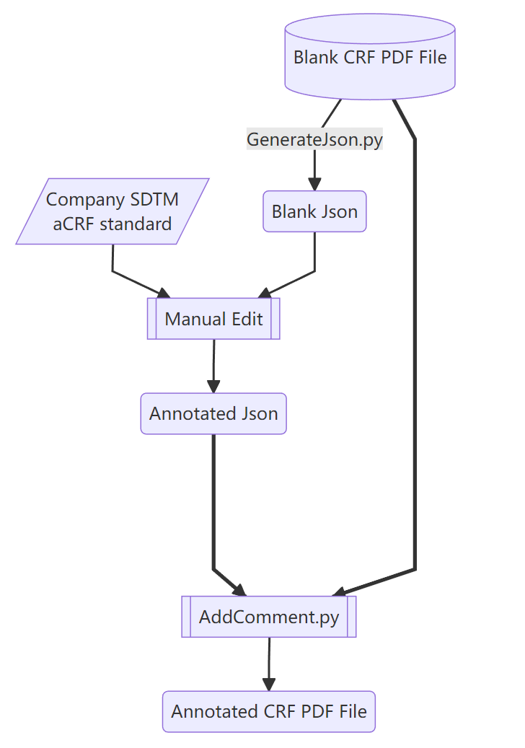
Implemention—WorkFlow
Paper Number AP-117

Slide 15
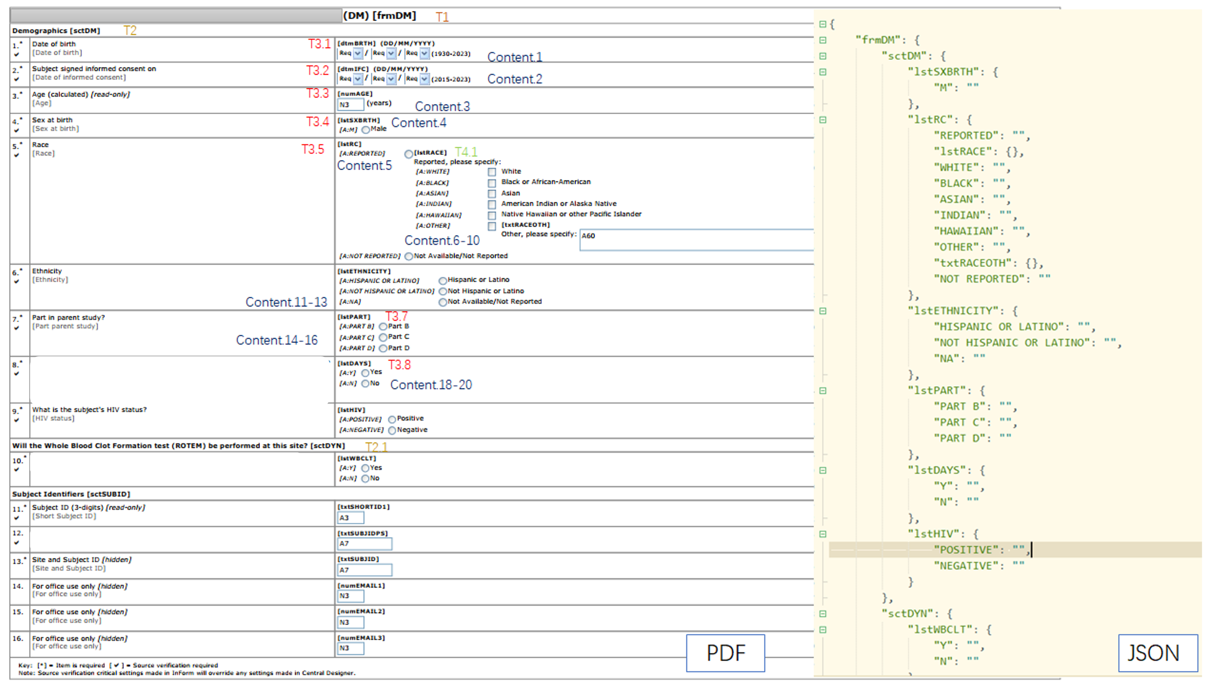
Implemention—PDF Parsing
Paper Number AP-117

Slide 16
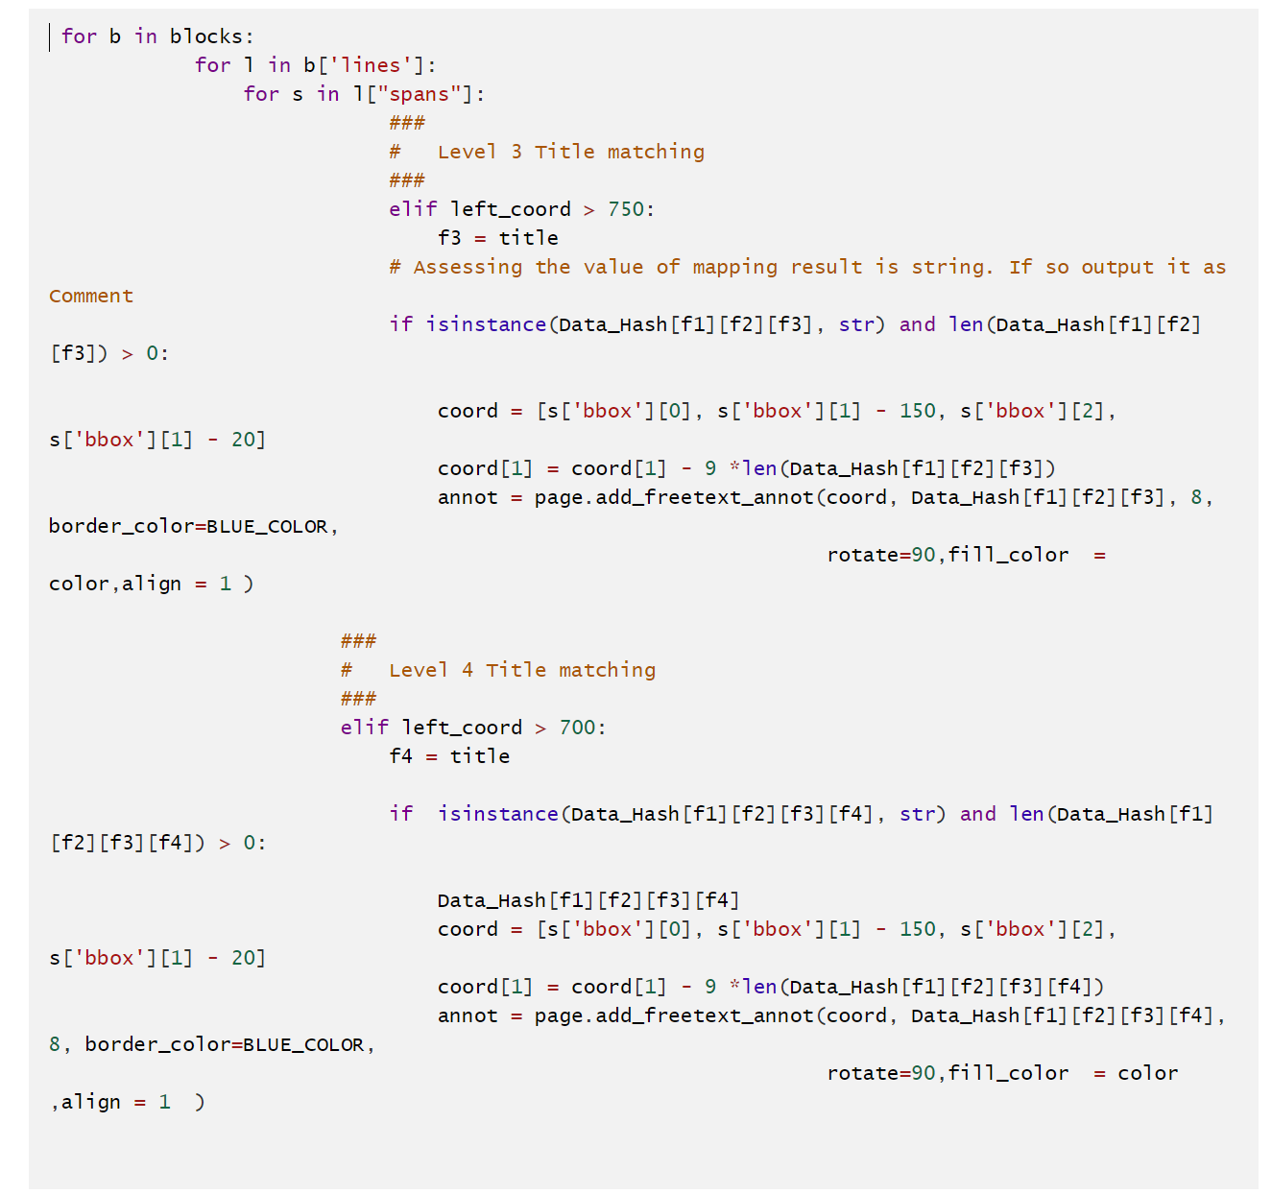
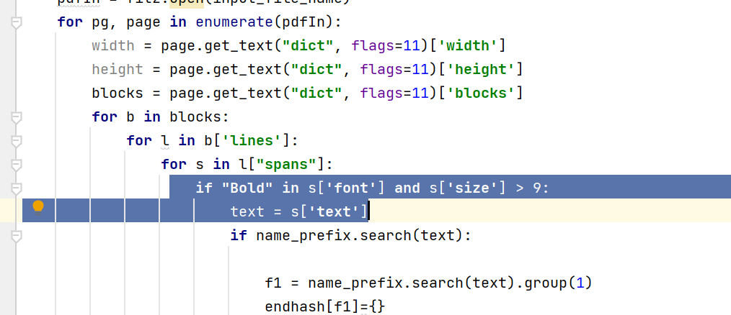
Implemention—PDF Parsing
A lot of meta data could be used as characteristics for distinguishing textual elements of whole documents, Such as :
Coordinate
Font size
Font family
Bold or Underline
Decorator or special punctuation such as bracket
Paper Number AP-117

Slide 17
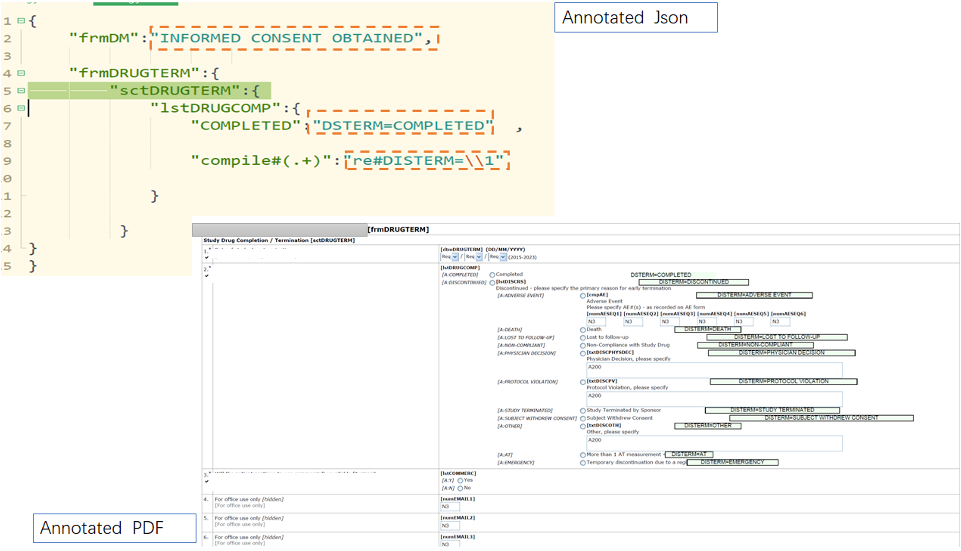
Implemention—WorkFlow
Paper Number AP-117

Slide 18
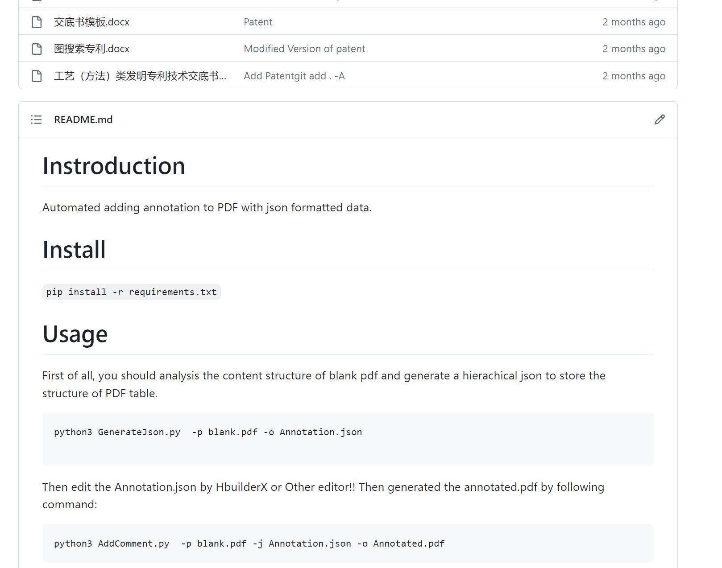
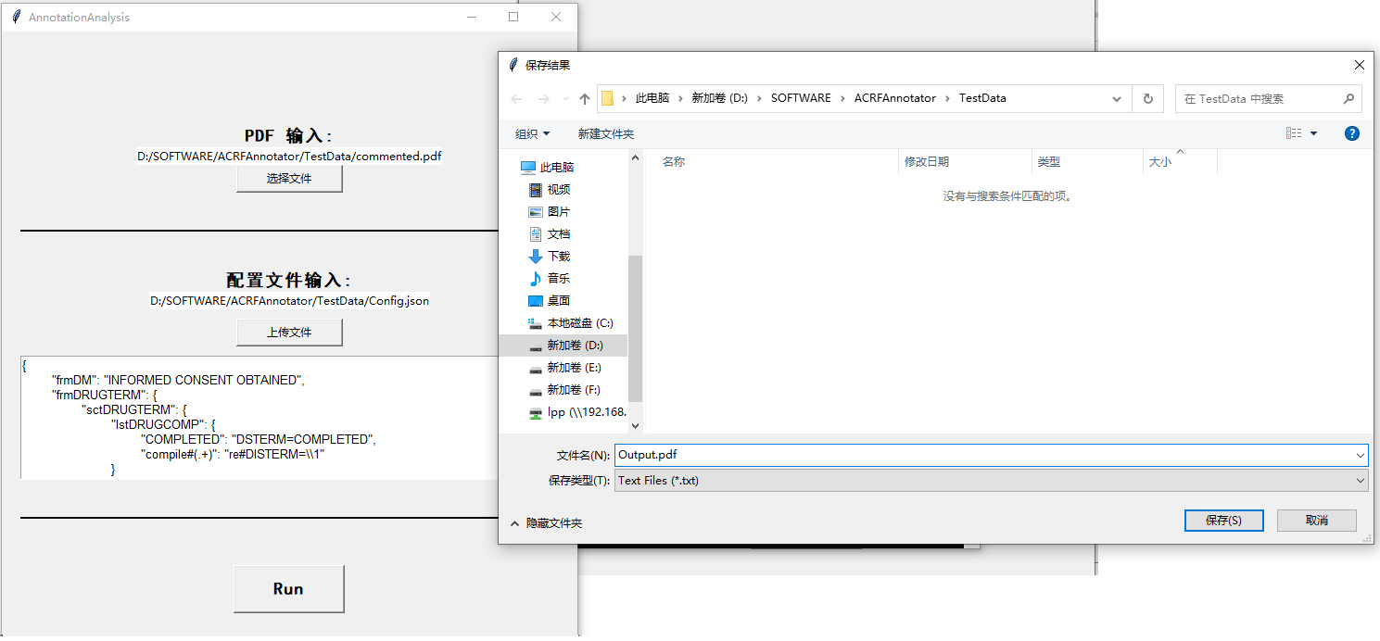
Implemention—SoftWarePackage
Paper Number AP-117

Slide 19
Advanced Skills

Slide 20
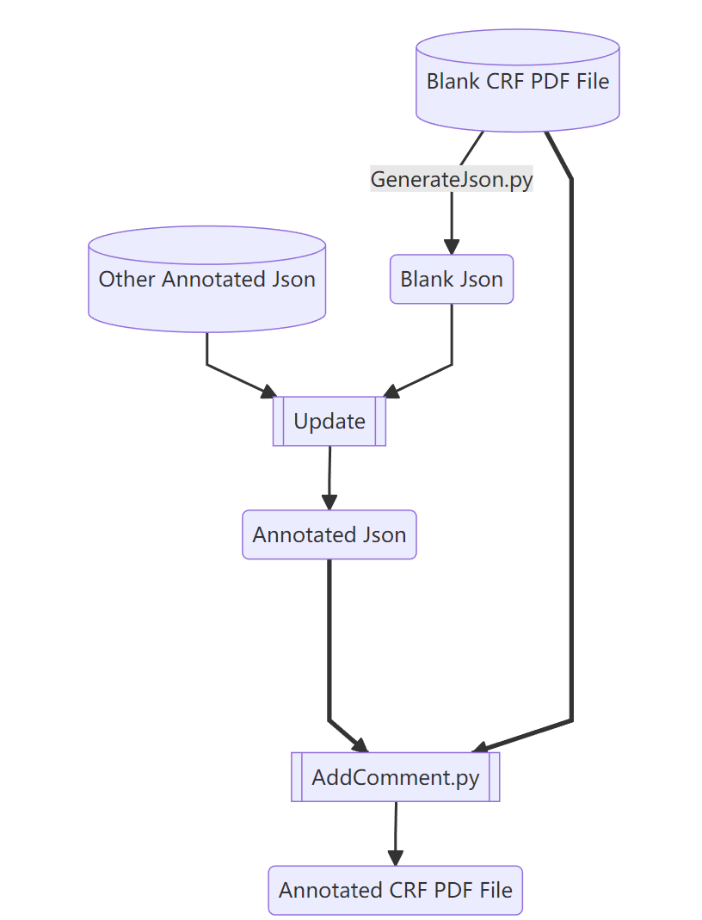
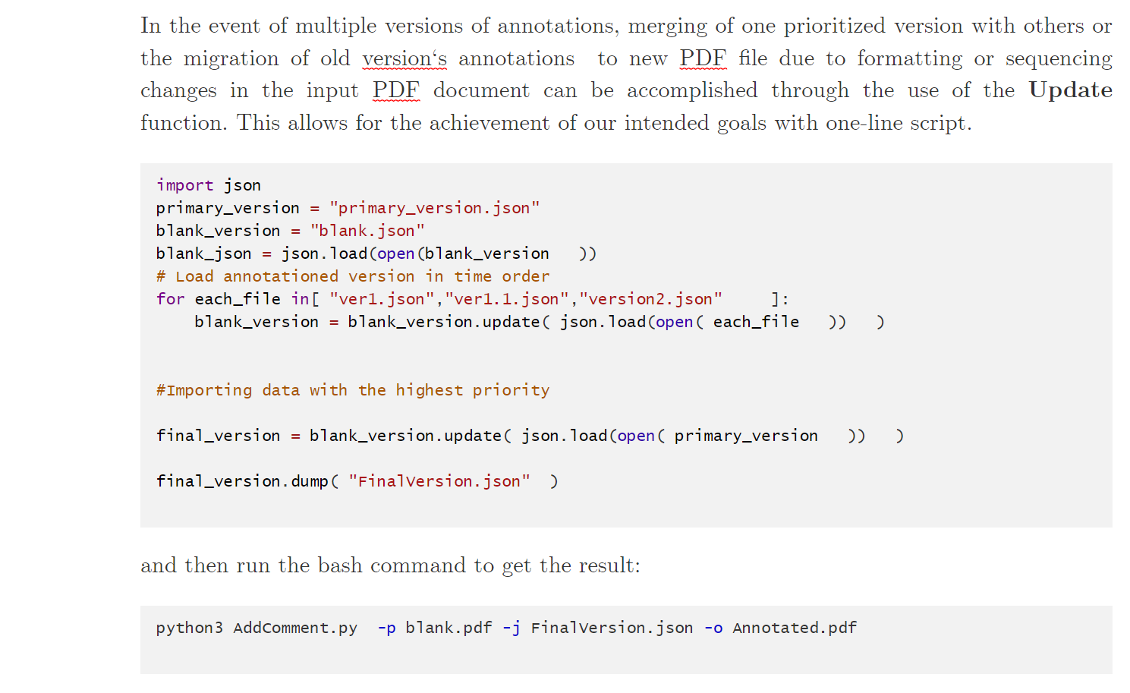
Advanced Skills
Annotation Migration

Slide 21
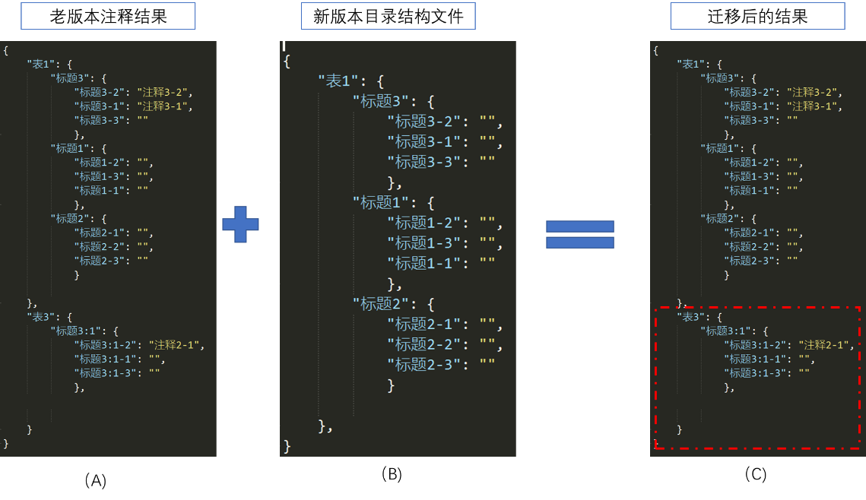
Advanced Skills
Annotation Migration

Slide 22
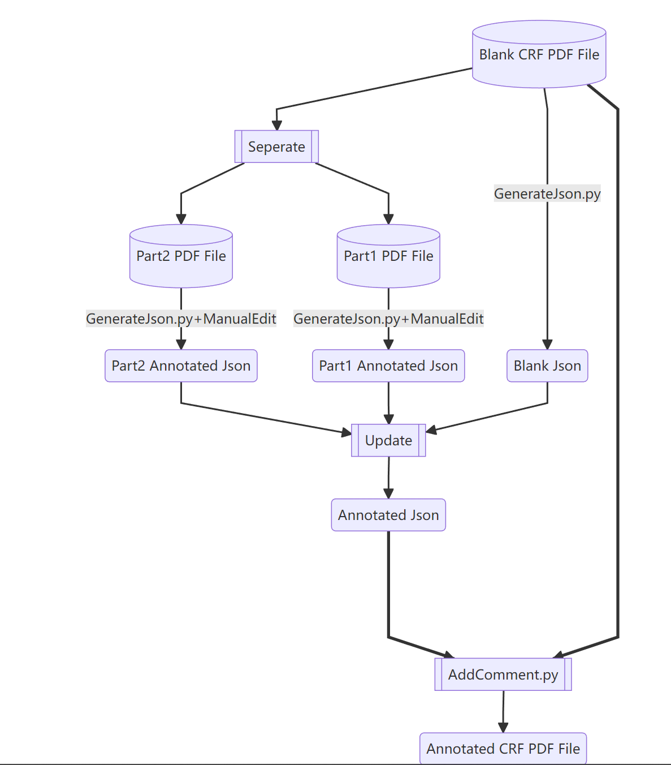
Advanced Skills
Divide-and-Conquer
Divide-and-Conquer

Slide 23
Future Work on going

Slide 24
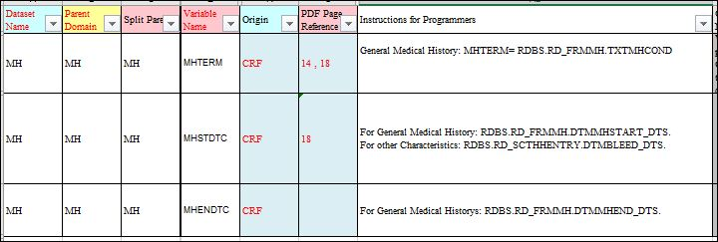
Future Work on going
Divide-and-Conquer
Bad coding style
Hard-readable table designing

Slide 25
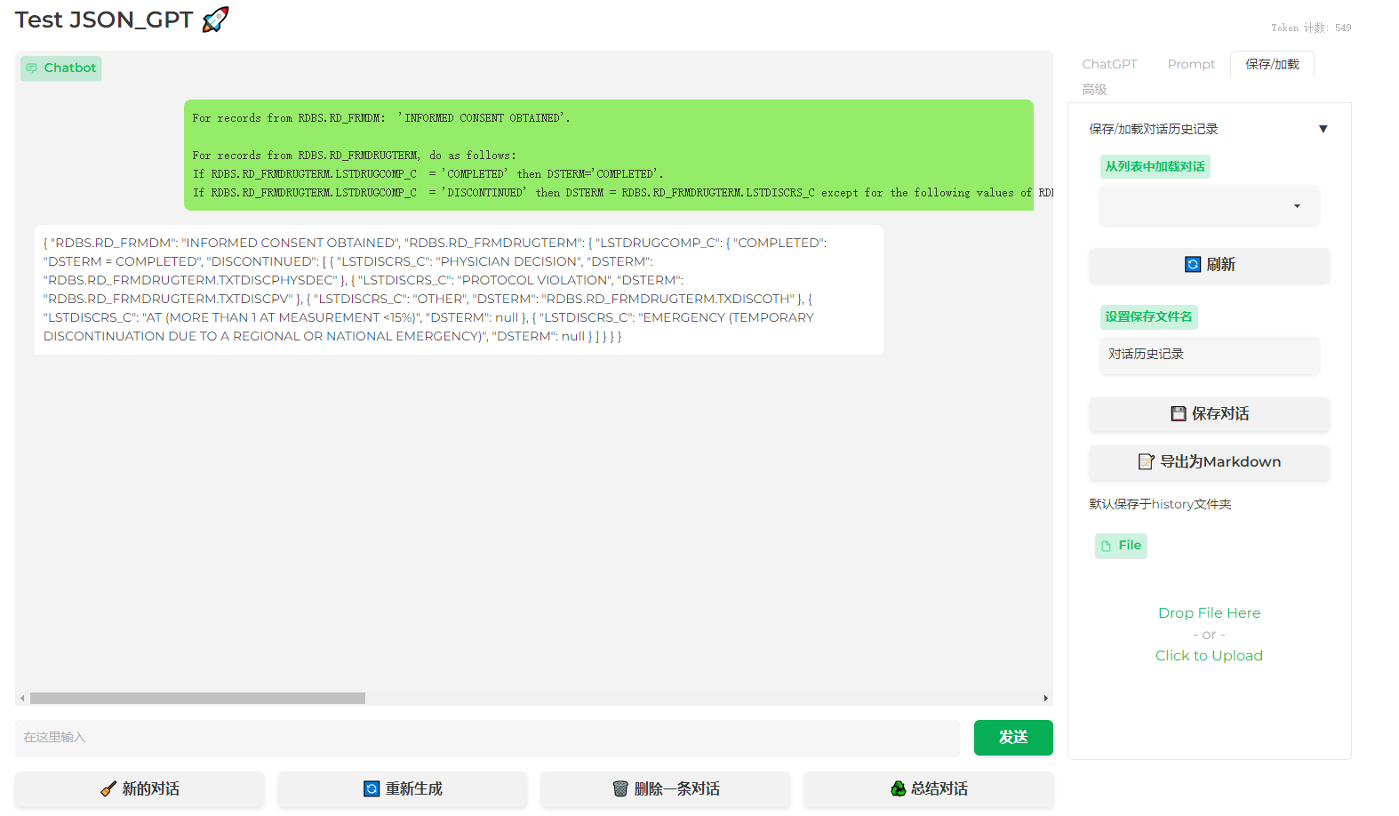
Future Work on going
Divide-and-Conquer
Use AI Engine to train a model to resolve this problem
ChatGLM6B+LongChain

Slide 26
Performance

Slide 27
Performance
Divide-and-Conquer
Computation Complexity
PDF Parsing
O(1)
Build Hash Tree
O(N)
Add Annotation
O(N)
N refer to total line number of whole document.
PDF File with 251 pages
30s for total analysis

Slide 28

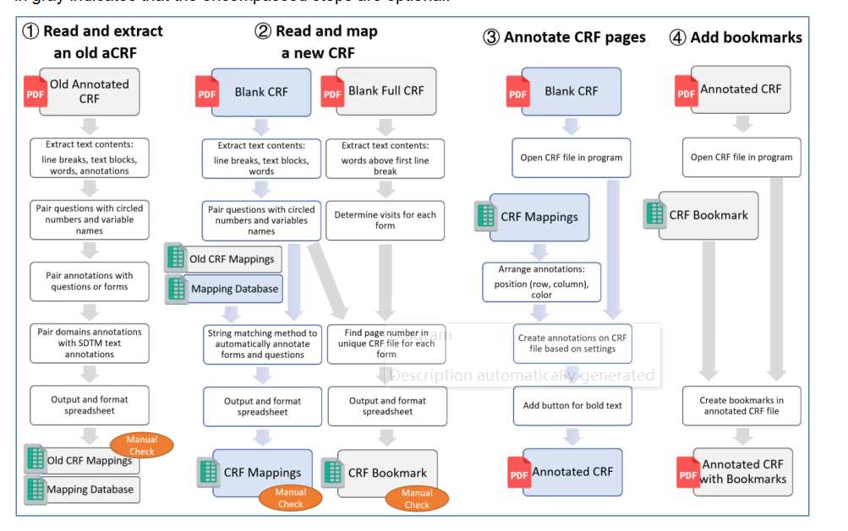
Performance
Divide-and-Conquer

Slide 29
Name: Li Pengpeng
Organization: BioEvov .co
Address: Tianjin
City, State ZIP: 300201
Work Phone: 17720159010
Fax:
E-mail: 409511038@qq.com
Web: www.bioevov.com
Twitter:

